Slide 1
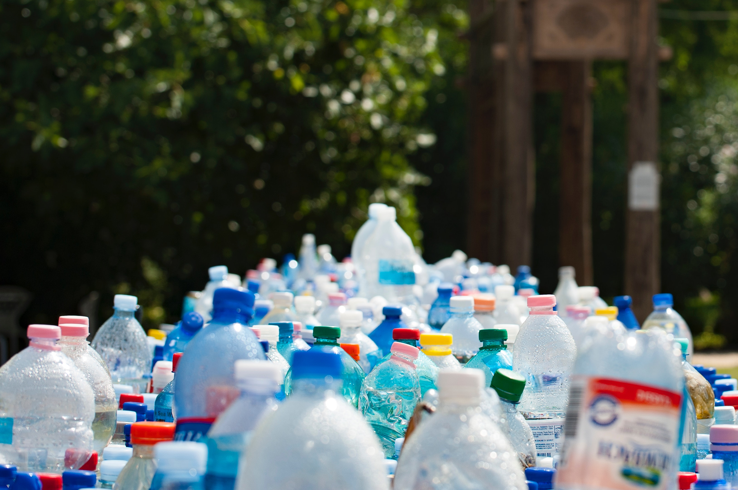
Recycling Effectiveness in Massachusetts
Statistical Analysis by Diana Giulietti
February, 2021

Slide 2




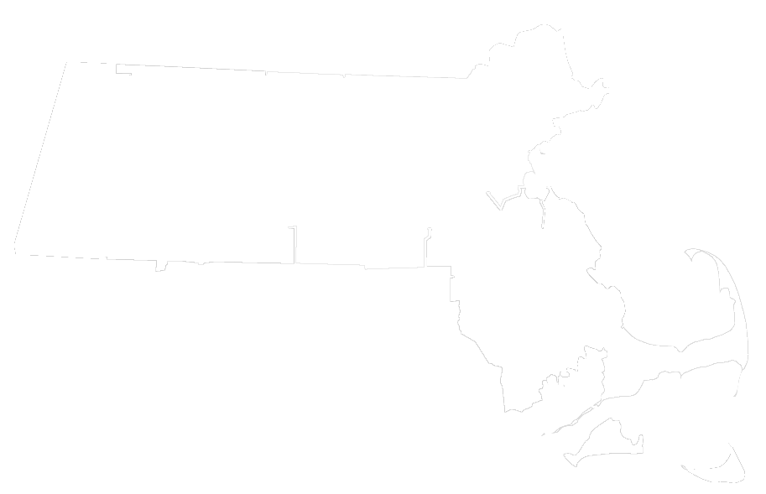

The Question – part 1
“ Which municipal waste handling services lead to higher rates of recycling per household?”

Slide 3
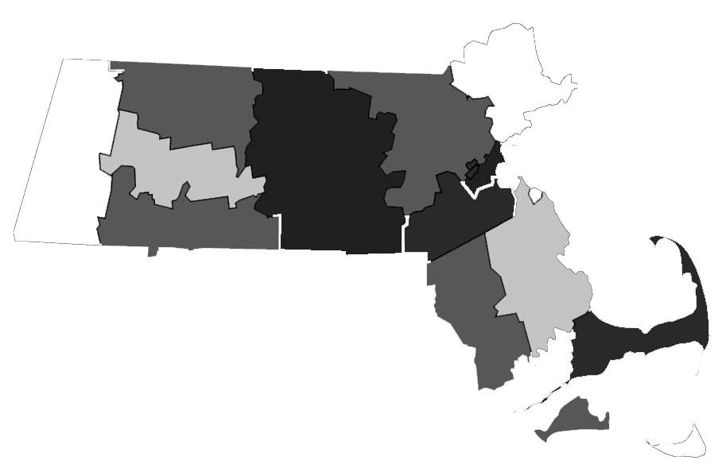
The Question – part 2
“ Do the trends behind the rates of recycling per household change within certain clusters of municipalities?”

Slide 4

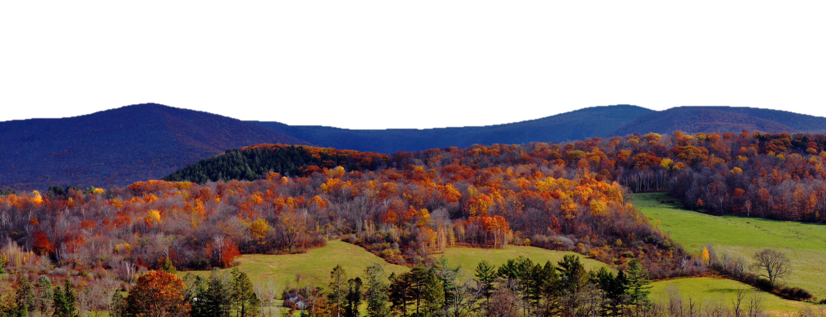
The Question – part 2
“ Do the trends behind the rates of recycling per household change within certain clusters of municipalities?
Boston
Williamstown

Slide 5


Data
MA Municipality Waste Handling Survey
No. of Households served
Tonnage collected for trash and recycling
Trash service type and volume of carts
Recycling service type and volume of carts
Program funding mechanisms
Mandatory recycling, who it applies to, and who enforces it

Slide 6
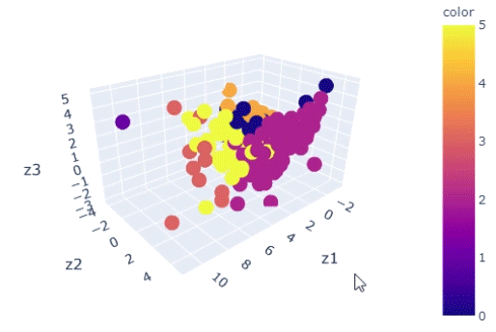
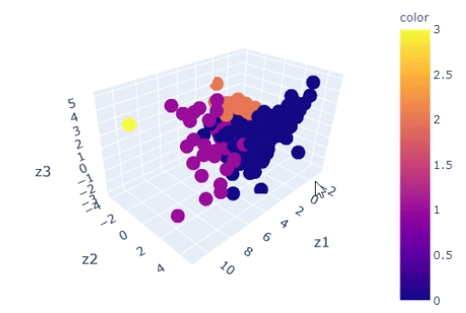
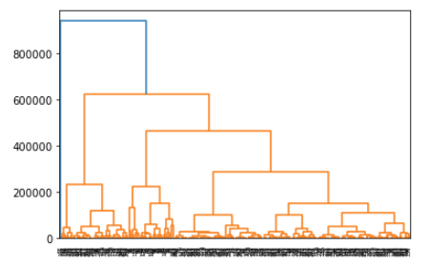
Clustering Municipalities
KMeans Clustering Schema
Hierarchical Clustering Schema
n = 6
(selected based on maximum number of clusters I’d feel comfortable analyzing)
n = 4
(based on analysis of dendrogram)

Slide 7
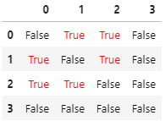
Clustering Municipalities
“Rural” – Label 0, 179 municipalities
“Sub-urban” – Label 2, 52 municipalities
“Urban” – Label 1, 35 municipalities
Boston – Label 3, only 1 municipality ☺
Hierarchical Clustering Schema
When looking at recycling rate distributions, each cluster was statistically different (Mann Whitney u-test)
n = 4
(based on analysis of dendrogram)

Slide 8
Baseline Models & Trends
Analysis of the Entire Population
 | Training Set Score | Test Set Score | RMSE | MAE
GS-optimized GradientBoost | 0.456 | 0.340 | 0.055 | 0.045
GradientBoost | 0.763 | 0.265 | 0.058 | 0.046
GS-optimized RandomForest | 0.575 | 0.260 | 0.058 | 0.045
GS-optimized Bagging | 0.573 | 0.253 | 0.059 | 0.045
RandomForest | 0.877 | 0.112 | 0.064 | 0.048
Bagging | 0.819 | 0.104 | 0.064 | 0.048
Dummy | 0.000 | -0.053 | 0.070 | 0.057

Slide 9
Baseline Models & Trends
Analysis of the Entire Population
 | GS-optimized GradientBoost
Households Served by Municipal Recycling Program | 0.240
Tip Fee as of 1/1/2020 | 0.180
PAYT/ SMART | 0.094
What is the annual fee? | 0.050
Fee for bulky waste? | 0.036
Does trash disposal tonnage include bulky waste? | 0.031
… | …
Annual Bulky Waste Limit | 0.000

Slide 10
Models & Trends within Clusters
Population Score to beat: 0.340, with GradientBoost
Rural
Suburban
Urban
 | Training Set Score | Test Set Score | RMSE | MAE
Bagging | 0.796 | 0.142 | 0.077 | 0.061
RandomForest | 0.839 | 0.132 | 0.078 | 0.060
GradientBoost | 0.495 | 0.059 | 0.081 | 0.062
Dummy | 0.000 | -0.018 | 0.084 | 0.068
 | Training Set Score | Test Set Score | RMSE | MAE
GradientBoost | 0.855 | 0.288 | 0.072 | 0.053
Bagging | 0.796 | 0.265 | 0.073 | 0.050
RandomForest | 0.892 | 0.261 | 0.073 | 0.053
Dummy | 0.000 | -0.022 | 0.086 | 0.065
 | Training Set Score | Test Set Score | RMSE | MAE
Bagging | 0.415 | 0.065 | 0.056 | 0.047
Dummy | 0.000 | -0.115 | 0.061 | 0.053
GradientBoost | 0.978 | -0.156 | 0.062 | 0.052
RandomForest | 0.857 | -0.273 | 0.065 | 0.055
* Tip Fee as of 1/1/2020
* PAYT/ SMART
What is the transfer station access fee?
* What is the annual fee?
* PAYT/ SMART
SS Recycling
* Tip Fee as of 1/1/2020
Recycling Collection Frequency
* Tip Fee as of 1/1/2020
Recycling enforcement applies to residential Generators not served by the Municipal Program
Annual Bulky Waste Limit
….
* Indicates same feature marked as important in the population

Slide 11
Take-aways
Q1 (Entire State) – households served and funding mechanisms were the most important attributes contributing to recycling success
Q2 (Subclusters) – Did not see an improvement in assessing recycling effectiveness in different subgroups of the population. This could be that there is too small of a sample size in each group or that the model setup could be improved.
Thank You!

